Slide 1
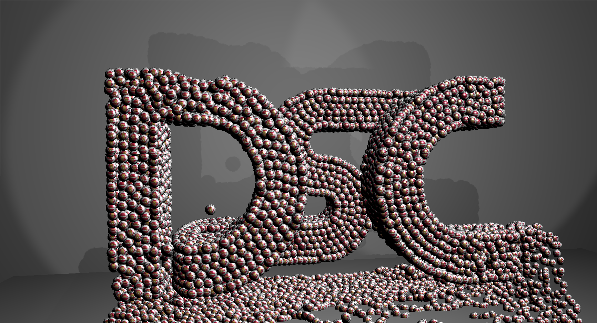


Multi-GPU Solutions of Geophysical PDEs with Radial Basis Function-generated Finite Differences
Evan F. Bollig
Nov 6th, 2013
499 DSL, 4:30 pm – 6:30 pm

Slide 2

Acknowledgements
This work is supported in part by NSF awards DMS-#0934331 (FSU), DMS-#0934317 (NCAR) and ATM-#0602100 (NCAR).
Computational resources provided by:
Keeneland Computing Facility at the Georgia Institute of Technology (NSF Contract OCI-0910735)

Slide 3
Investigation Focus
Notes:
Topics covered in this defense: a) the application of a recent numerical method (barely cuts into the numerical method domain. b) a distributed implementation of RBF-FD that runs on multi-GPUs (heavy into the hardware and software). c) neighbor query algorithm (software)

Slide 4
Overview
Preliminaries
Introduction to GPUs
Introduction to RBF-FD
Code Verification Details
A Fixed-Grid Method for RBF Methods
Space Filling Curves and Node Ordering
Lasting Impacts on Performance
Single GPU RBF-FD
Targeting Multi-GPU Clusters
MPI Tuning
Overlapping Communication and Computation
Conclusions
Notes:
Introduction to RBF methods (beyond RBF-FD)?

Slide 5
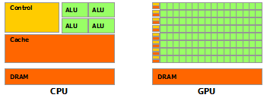
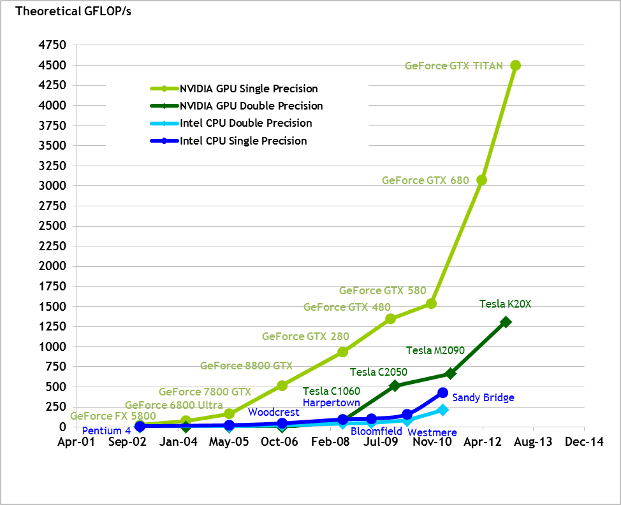
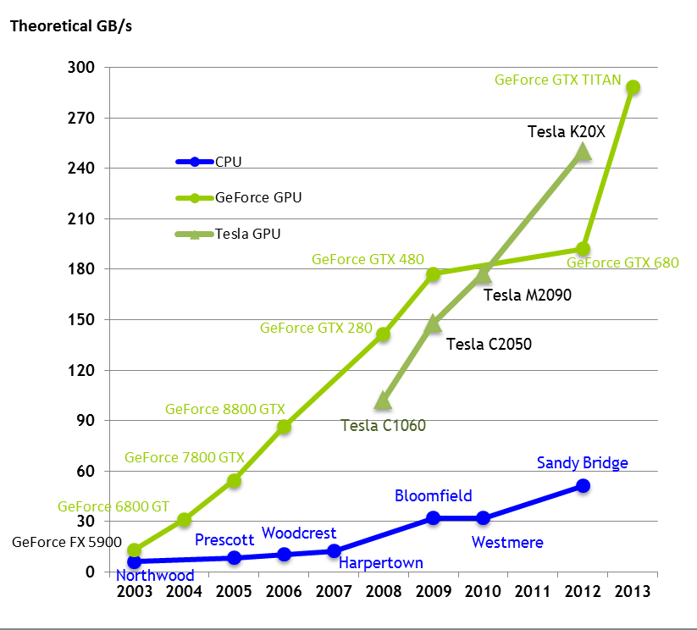
Why GPUs?
Images courtesy of NVidia
Massive parallelism
High GFLOP/sec
Fast Memory
Notes:
Since the early 2000’s frequency scaling is no longer an option
Parallelism is mandatory to continue with Moore’s law.

Slide 6
How to Target GPUs?

Slide 7
GPU Memory Model
Notes:
GPU loads memory in 128byte segments. Align on those for best register density.

Slide 8
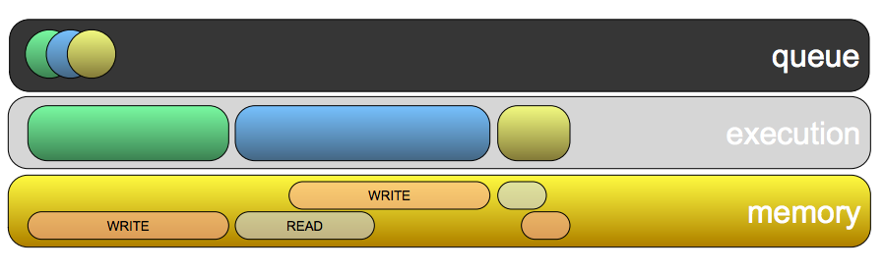
OpenCL Event Queues
Queues allow non-blocking kernel launches
Concurrent kernel execution (on Fermi and Kepler GPUs)
Shared memory pool between queues.
Image courtesy of Gerstmann, 2009. Advanced OpenCL Event Model Usage (tutorial slides)

Slide 9
Target: GPU Cluster
Keeneland Initial Delivery (KID) System
360 NVidia M2070
Cascade
32 NVidia M2070 (4 per node)
8 NVidia K20

Slide 10
Multi-GPU Concerns
How to partition and distribute our problem?
Faster computation increases relative cost of communication. Can it be amortized/hidden?
Multi-GPU OpenCL requires device ←→ host copies. Can they be hidden?

Slide 11
What is a Radial Basis Function?
A radially symmetric function centered at
Notes:
Note the support parameter

Slide 12
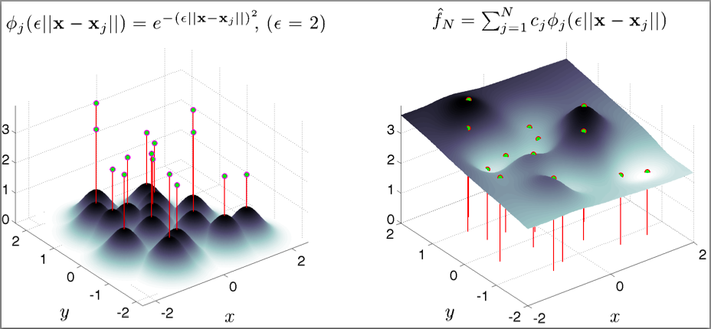
RBF-Interpolation
Notes:
Arise by enforcing

Slide 13
Pros/Cons of RBF Methods
Pros
Function independent of dimension
Operate on unstructured meshes
High order convergence
Large time-steps
Cons
Support parameter,
Uncertainty Relation (Schaback, 1995)
Can be overcome with RBF-QR (Fornberg and Piret, 2007), RBF-GA (Fornberg, Lehto and Powell, 2013)

Slide 14
RBF-generated Finite Differences (RBF-FD)
Classical FD (1-D*):
*Nonsingularity lost in 2-D; compose weights across dimensions
RBF-FD (d-D):

Slide 15
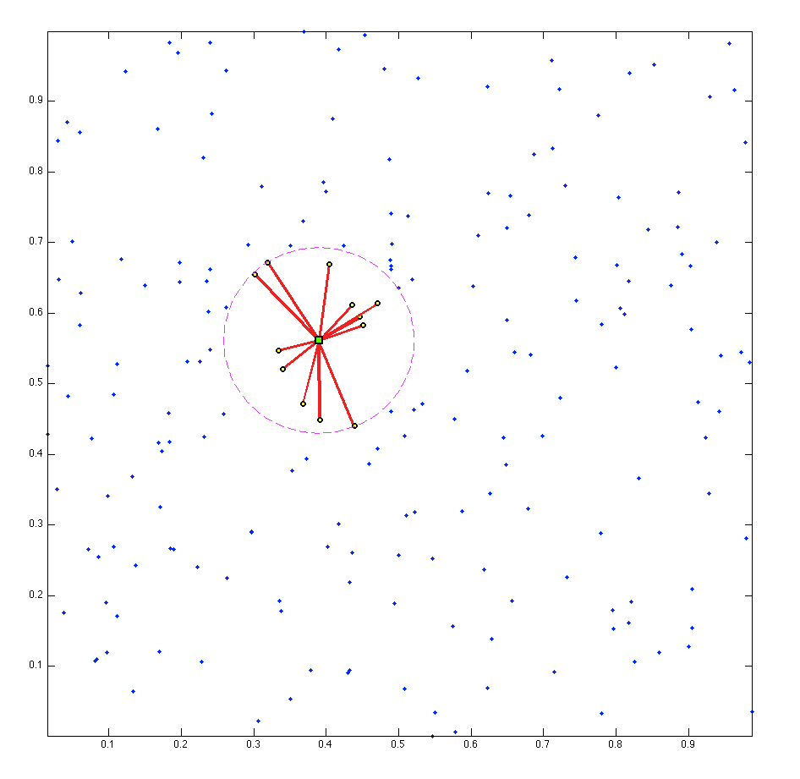
What Kind of Stencils?

Slide 16
Differentiation Matrix (DM)
Sparse Matrix
n-nonzeros per row (stencil size)
Unsymmetric (unique weights per row)
Sparse Matrix Vector (SpMV) multiply to get derivative across full domain

Slide 17
Multiple Linear Operators
Solve for weights with LAPACK dgesv or other efficient direct solver
Analytically apply operators to the RBF or compose operators like classical FD

Slide 18
Some Weight Operators
First and Second Derivatives:
Cartesian Gradient:
Cartesian Laplacian:

Slide 19
RBF-FD for Time-Dependent PDEs
Assume an input grid is provided.
We focus on stencil generation, decomposition and the Application Phase.

Slide 20
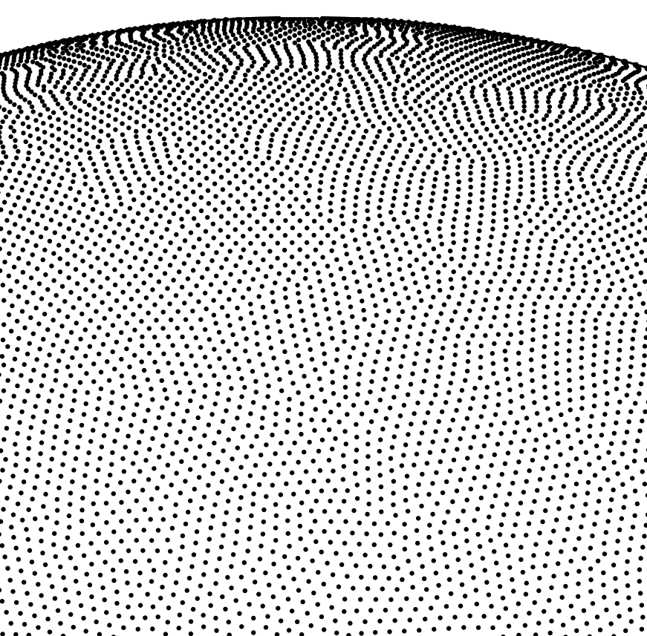
Unit Sphere Test Grids
Icosahedral (Geodesic) Grid
Spherical Centroidal Voronoi Tessellation
Maximum Determinant (MD)

Slide 21
Related Work on Multi-GPU
Notes:
RBF OpenMP: \cite{Kosec2008} happy with 1.85x speedup using two cores
RBF MPI: \cite{Divo2005, Divo2007, Ingber2003,Ingber2004,Yokota2010}
Divo and Kassab: 10 compute nodes, then 36. Solving conjugate heat transfer problems.
Ingber: 3D diffusion equations up to 64 nodes
Yokota: RBF interpolation as component of PDE solve
RBF CUDA: \cite{Schmidt2009a,Schmidt2009b,Gumerov2007a, Gumerov2007b}
Schmidt global rbf collocation (dense matrix)
Gumerov rbf interpolation inside FMM method (dense matrix)

Slide 22
Verification
Solve hyperbolic equations with DMs of the form:
Apply hyperviscosity (Fornberg and Lehto, 2011) to filter spurious eigenmodes
Operator:
Applied as:
With scaling:
Tuned hyperviscosity parameters are based on trial and error

Slide 23
Support Parameter

Slide 24
Vortex Roll-Up
Purpose: Spin a fluid into two diametrically opposed but stationary vortices.
Solve with Method of Lines:
Notes:
Latitude longitude (theta lambda)

Slide 26
Convergence (Vortex Roll-Up)
t=3

Slide 27
Cosine Bell Advection
Purpose: advect a solid body around the sphere
Method of Lines with two DMs intentionally separated*:
* See appendix for discussion on avoiding pole singularities

Slide 28
Notes:
C1 bell with discontinuity in derivative

Slide 29
Stability and Convergence of Cosine Bell Advection
10 revolutions

Slide 30
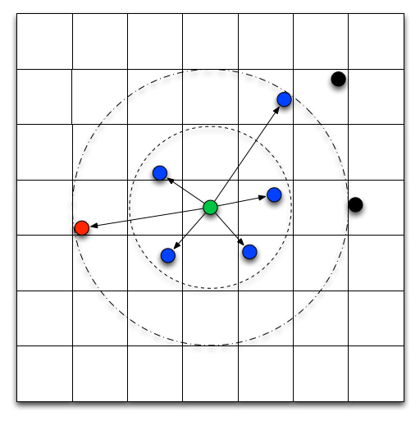
Neighbor Query
We introduce the fixed-grid method to the RBF community for stencil generation
Results in minimal gains for stencil generation but works well as preconditioning on nodes for SpMV performance.

Slide 31
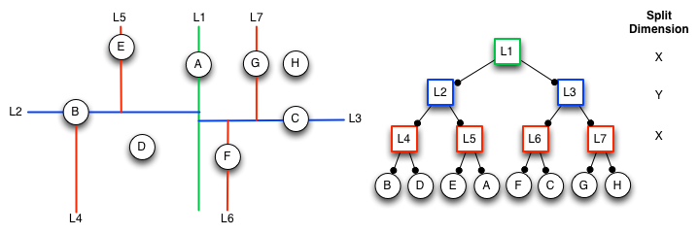
kD-Tree

Slide 32
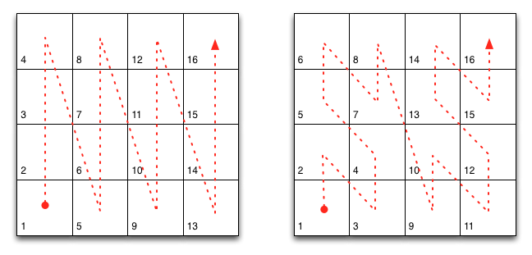
Fixed Grid
Space-filling curves optional

Slide 33
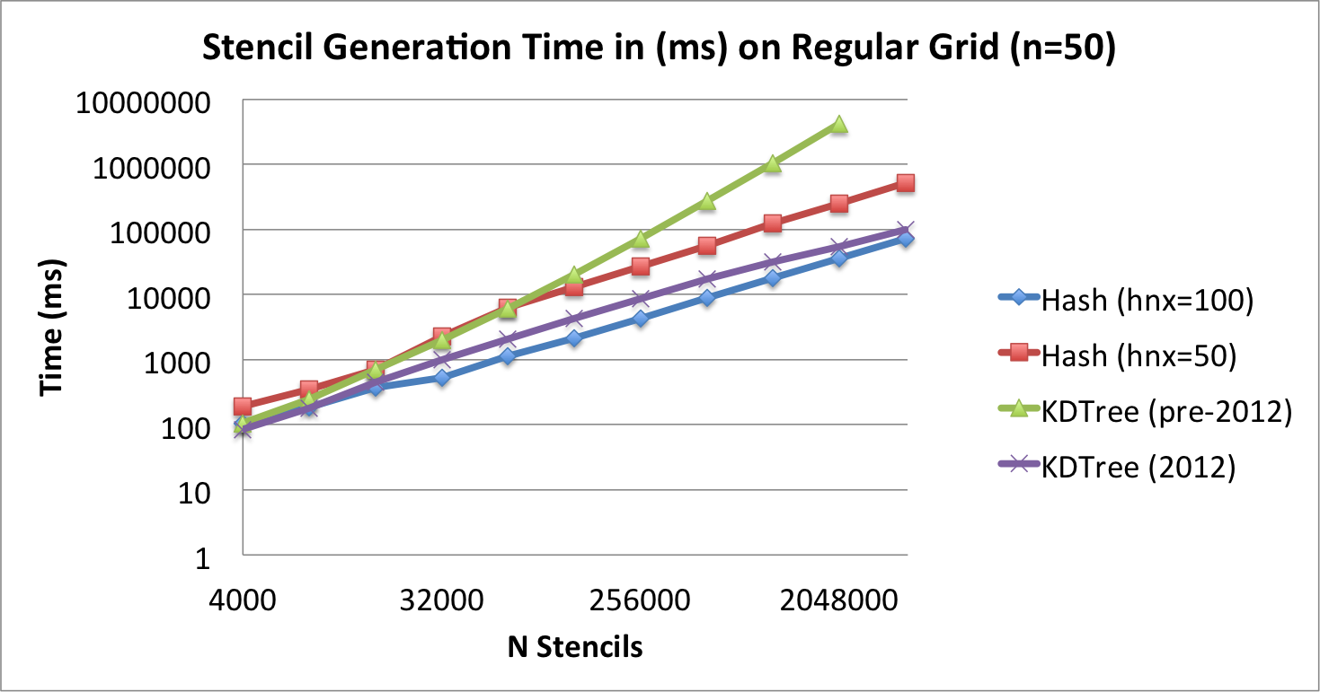
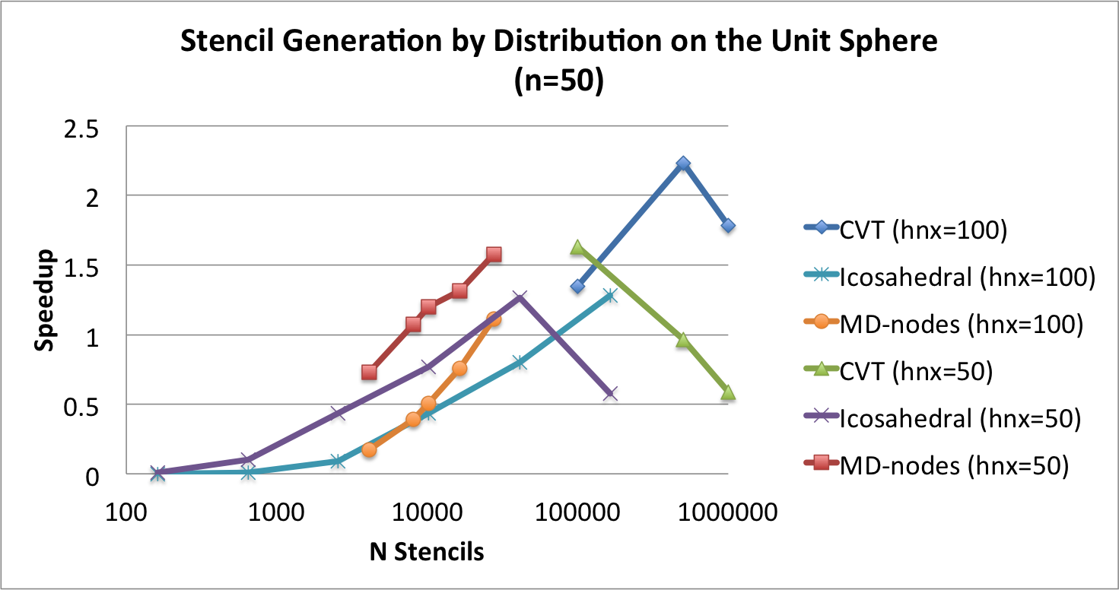
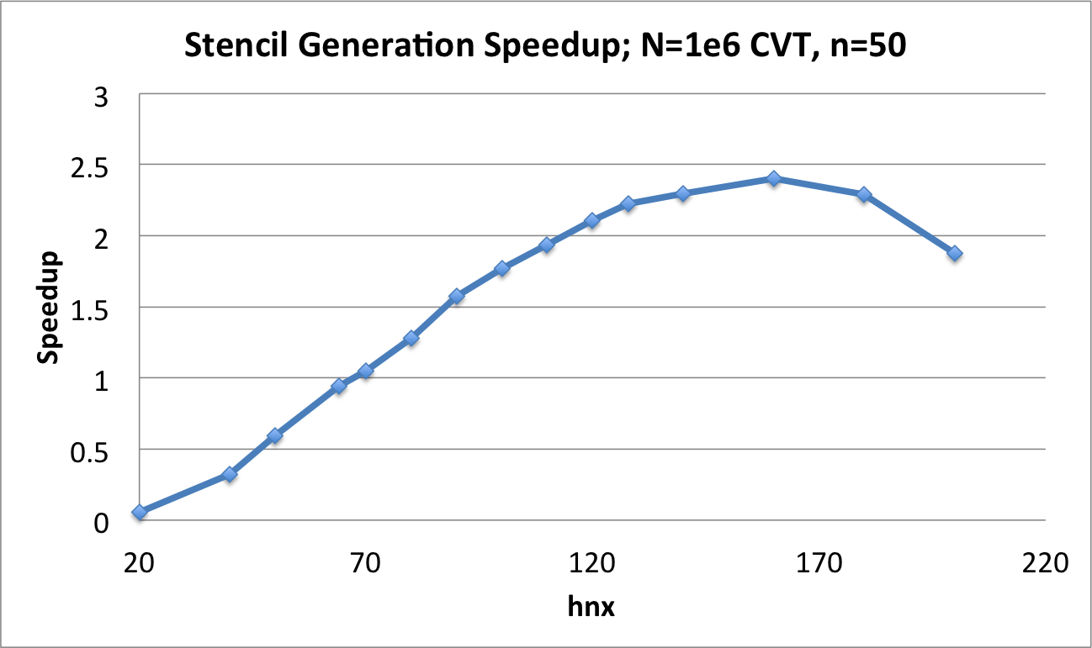
Raster Order Fixed Grid Impact
Up to 2x faster for h_{n}=100 on uniform nodes
Up to 2.5x faster for h_{n}=100 on random nodes

Slide 34
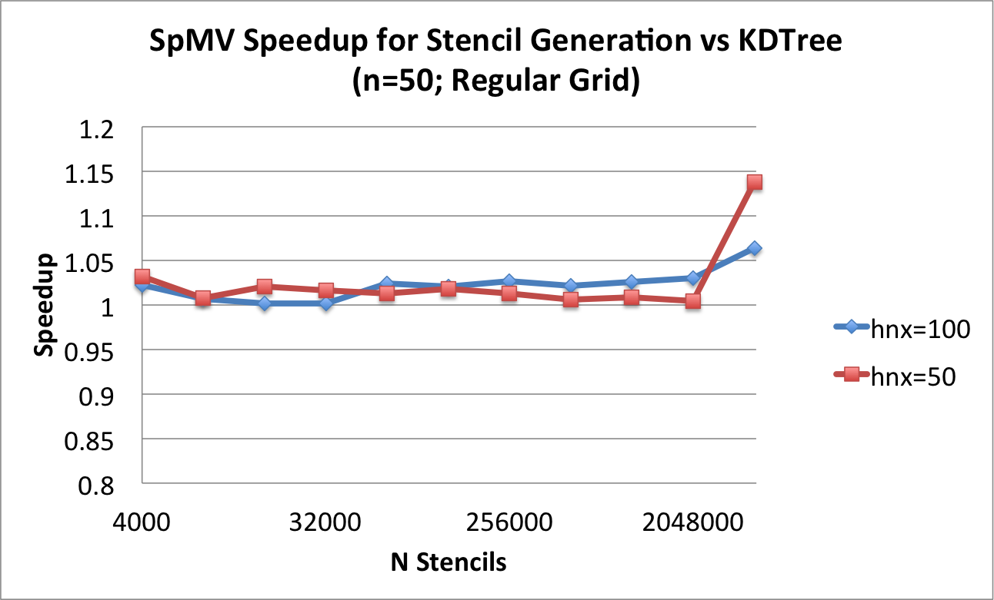
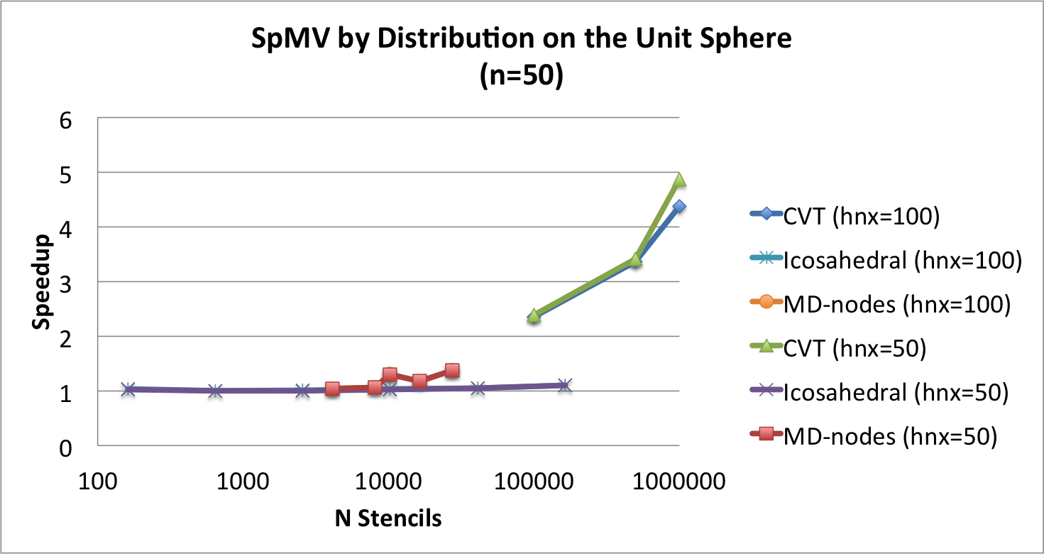
SpMV Impact of Raster Order Fixed-Grid
No negative impact on regular grids
Up to 5x speedup for random nodes

Slide 35
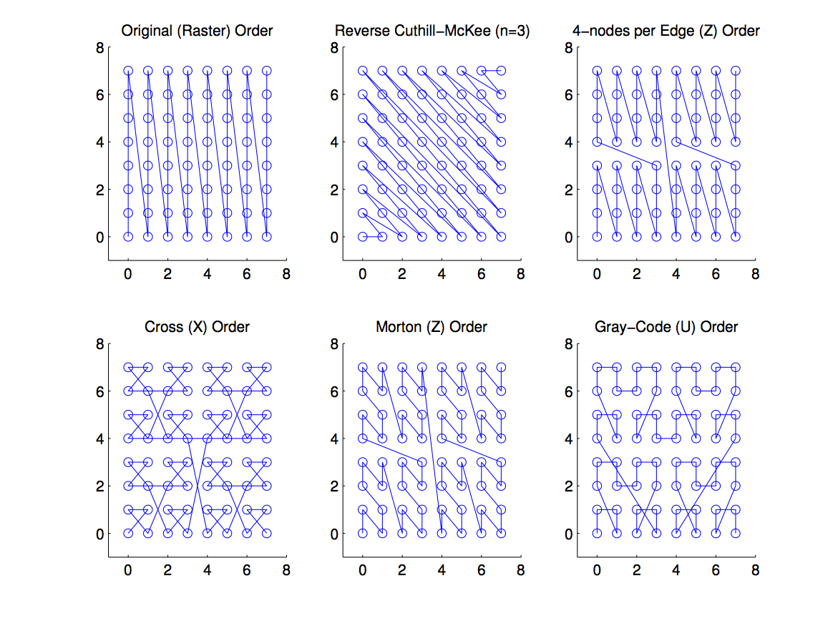
Orderings

Slide 36
Integer Dilation and Interleaving
Example:
Orderings:

Slide 37
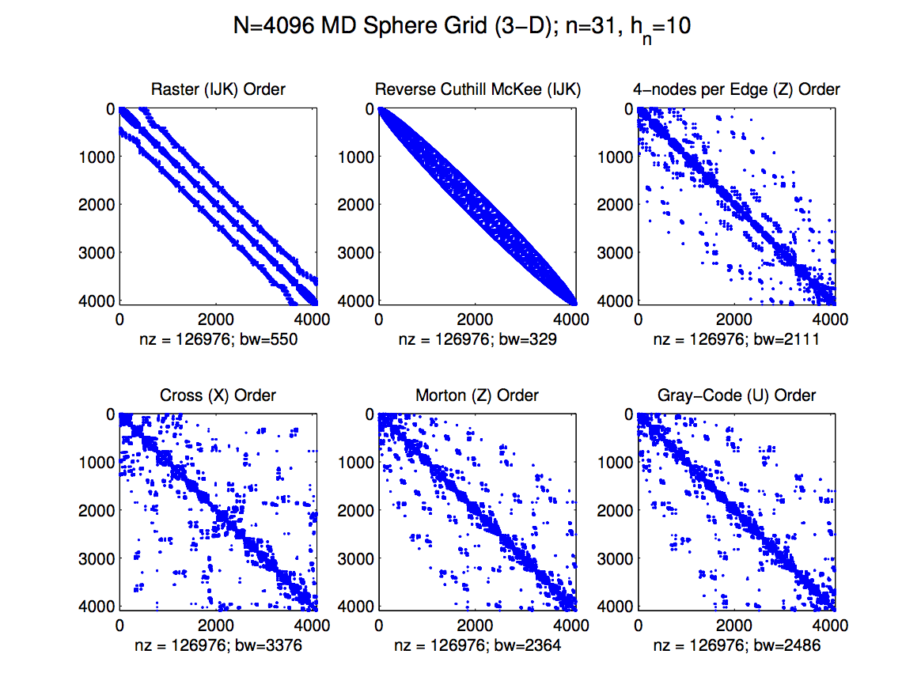

Slide 38
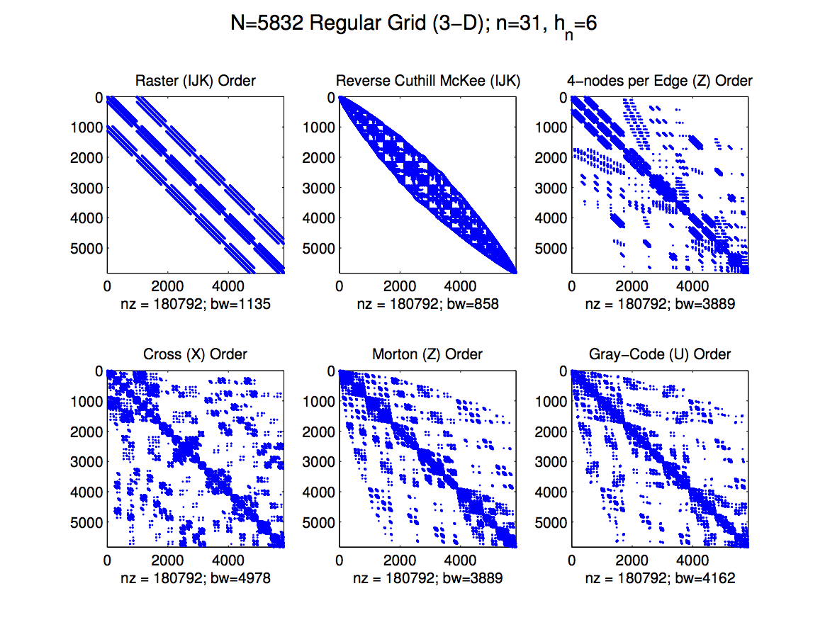

Slide 39
Fixed Grid Improvements
RCM works best given random distribution
Bandwidth is not the key to optimal performance

Slide 40
GPU Comparison
Fermi M2070
Kepler K20
Memory: 6GB
Bandwidth: 148 GB/s
DP Peak: 515 GFLOP/sec
Multiprocessors: 14
Cores: 448 (32 per Multiprocessor)
Memory: 5GB
Bandwidth: 208 GB/s
DP Peak: 1.17 TFLOP/s
Multiprocessors: 13
Cores: 2496 (192 per Multiprocessor)

Slide 41
Roofline Model (Williams et al. 2009)
The roofline model predicts MAXIMUM possible performance on the hardware.
RBF-FD SpMV is only 1/8 FLOPs:bytes (double precision)

Slide 42
Custom RK4
RK4 time-scheme:
Reusable kernels called as:

Slide 43
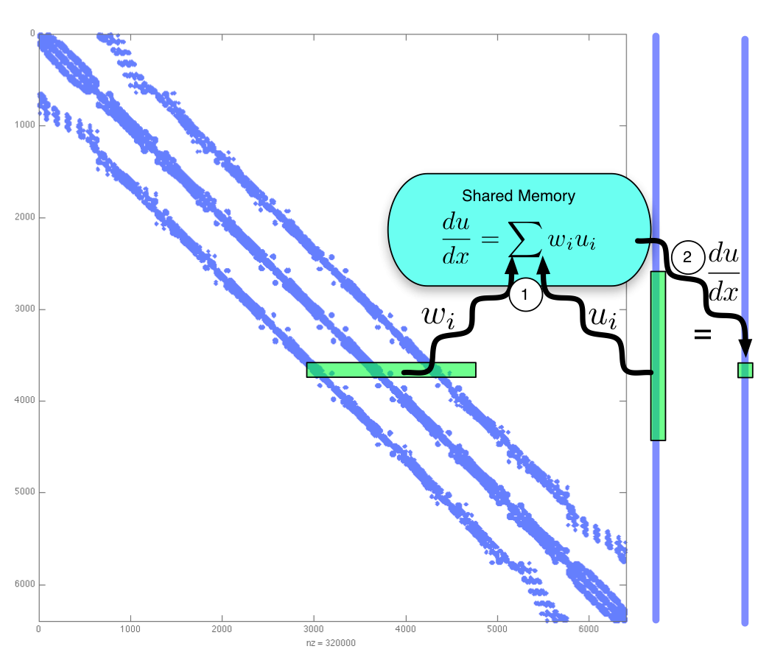
One Thread per Stencil
Pros:
All stencils have the same number of operations (perfect concurrency)
Cons:
Threads may access disparate areas of memory
Large stencils

Slide 44
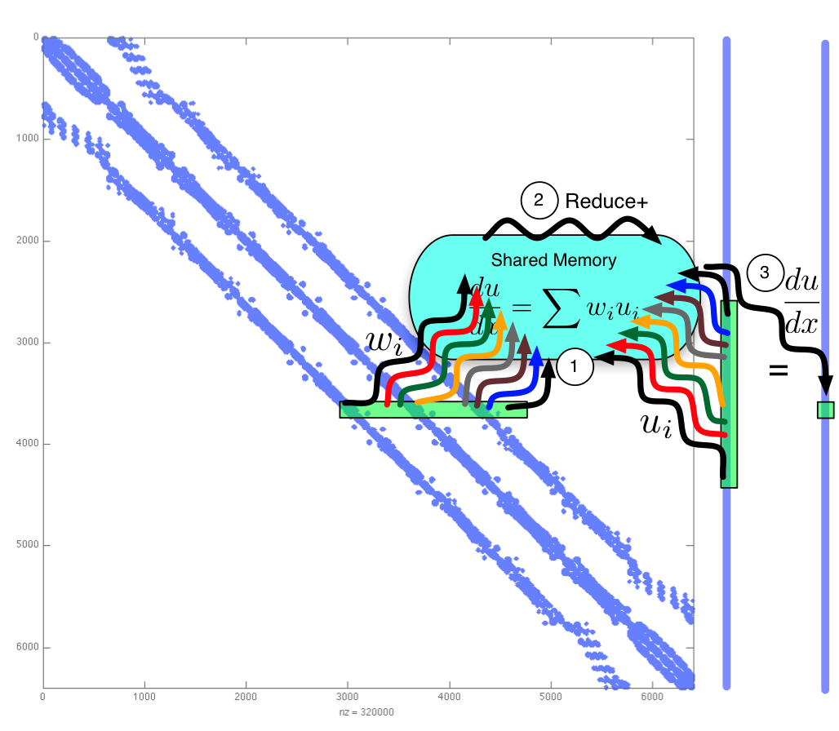
One Warp per Stencil
Pros:
GPU operates in warps, so memory loads are shared
Cons:
Only 32 threads queued per stencil on single multiprocessor

Slide 45
Custom Kernel Performance (Keeneland M2070)

Slide 46
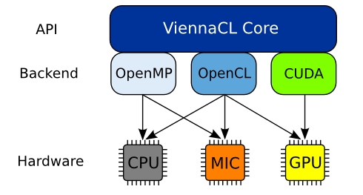
ViennaCL
Recently integrated into PETSc!
Started assisting on the ViennaCL project (Summer 2010)
Extensions for rectangular matrices, ILU0, distributed SpMV + GMRES
Integrated into RBF-FD code
Benefit from existing optimizations for SpMV (formats)

Slide 47
Memory Compression (Sparse Storage)
O(3*n*N)
O((2*n+1)*N)
O(2*n*N)

Slide 48
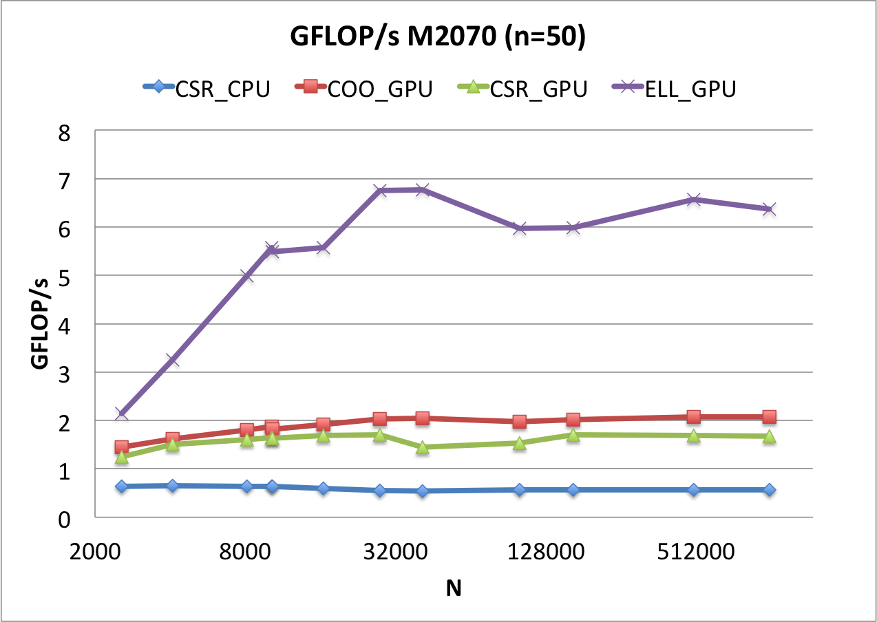
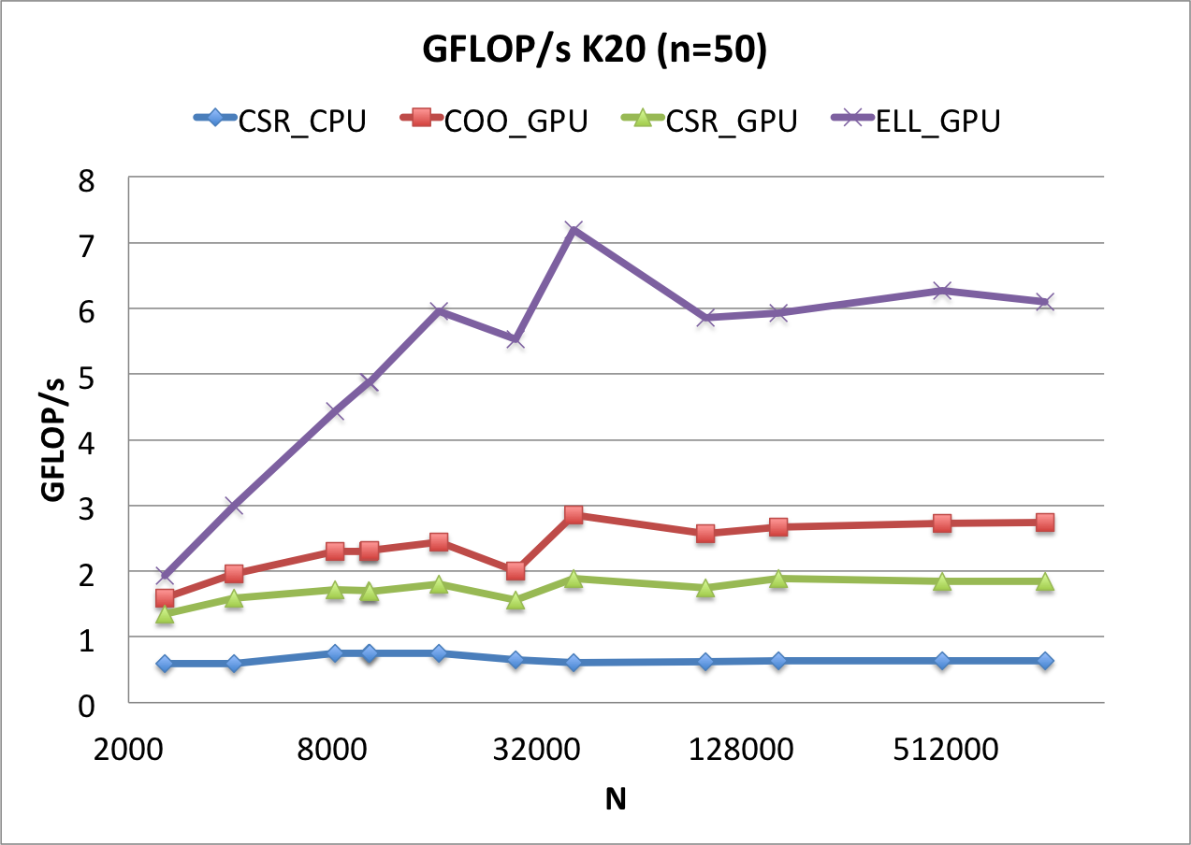
Single GPU

Slide 49
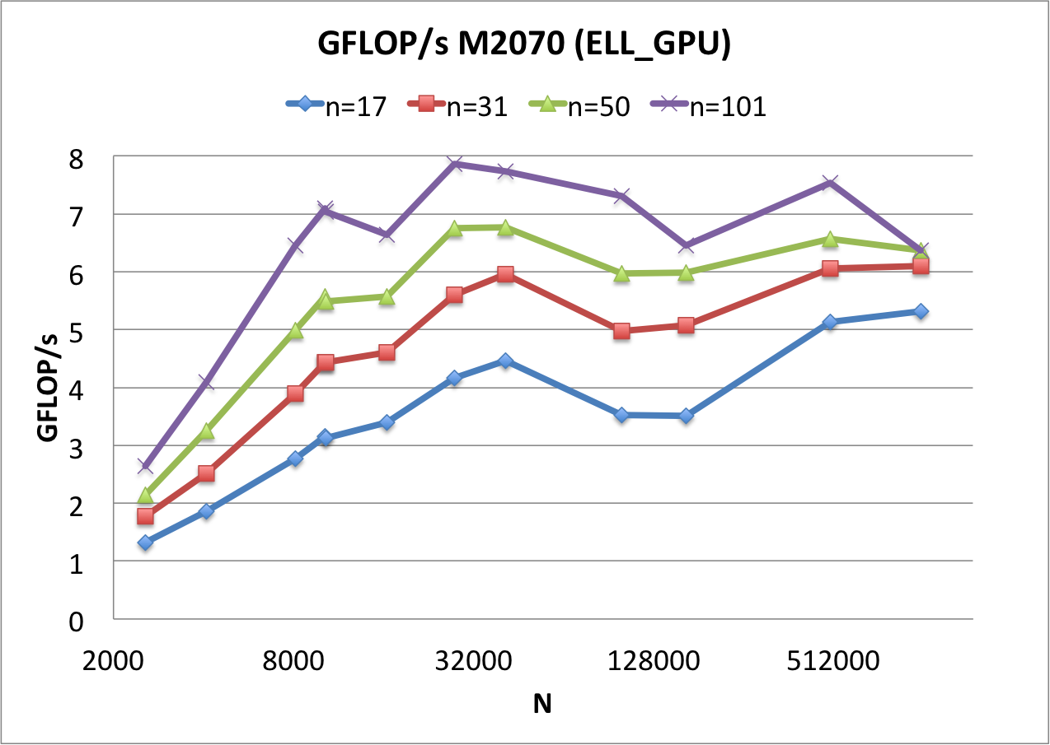
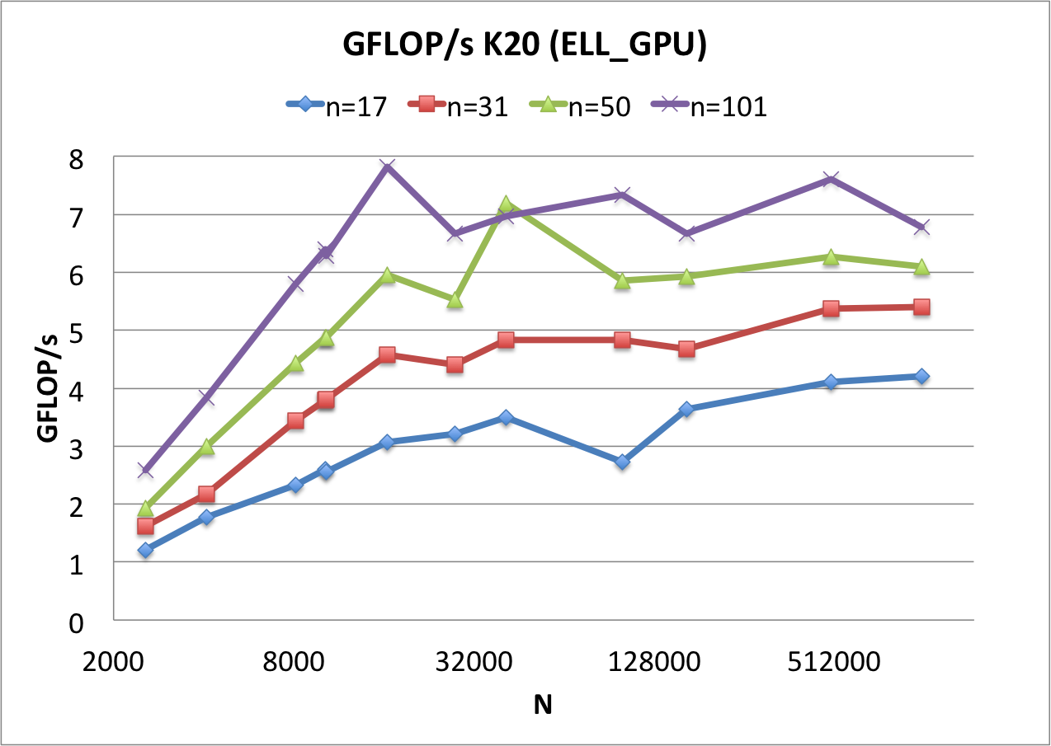
Peak ELL GFLOP/sec on Single GPU
Fermi and Kepler perform the same.
Notes:
Note that NVidia support for OpenCL is lacking

Slide 50
Future Work for GPU SpMV Performance
Other Formats
BELL, SELL, SBELL, etc.
Fewer memory loads
Ordering
Register packing (non-zero condensation)
More operations (Erlebacher et al. 2013)

Slide 51
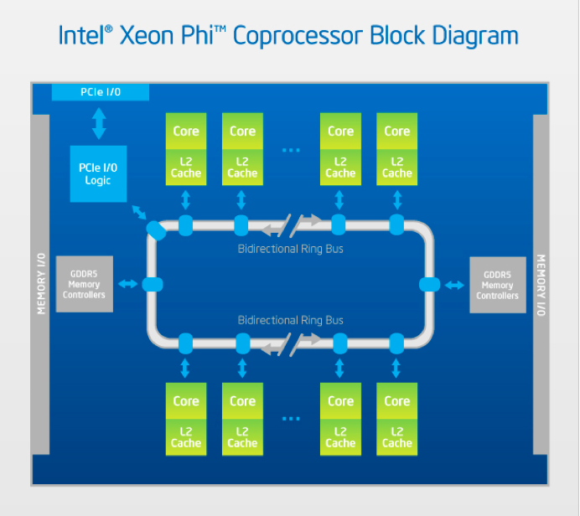
Performance Portability? Intel Phi
2013 OpenCL
Beta Driver

Slide 52
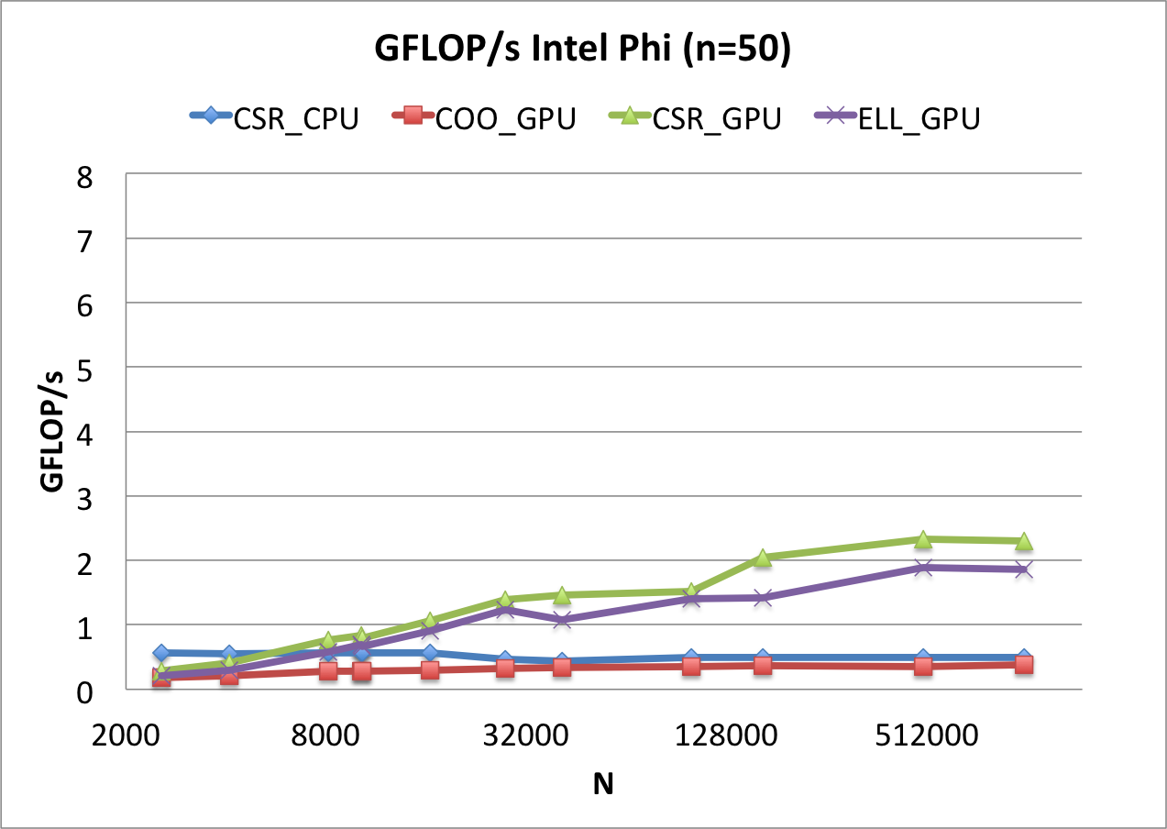
Preliminary Data: Intel Phi

Slide 53
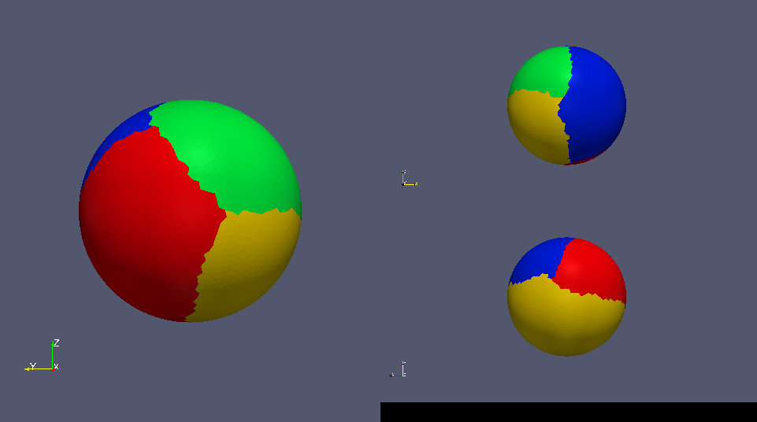
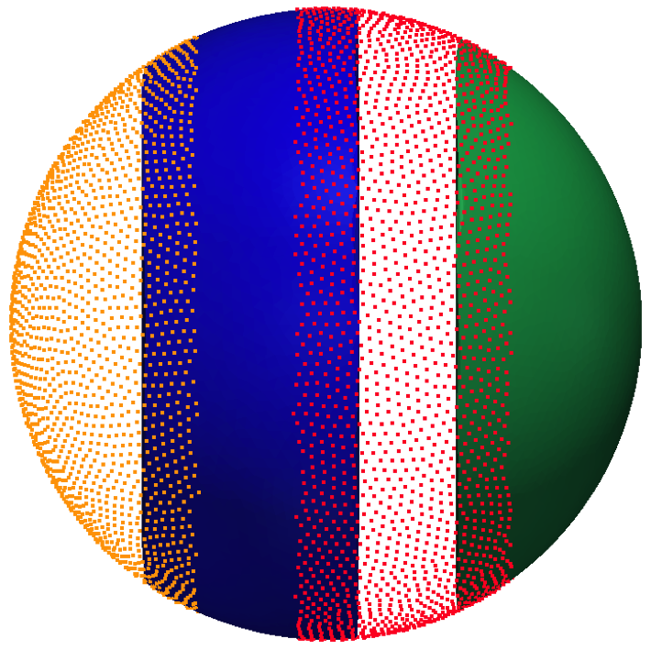
Domain Decomposition
Restricted Additive Schwarz Method
Graph partitioning with METIS for load balancing (Karypis and Kumar, 1999)
Requires symmetric adjacency matrix:

Slide 54
Load Balancing with METIS
Load balancing impacts parallel gains:
Ghost nodes are the killer!

Slide 55
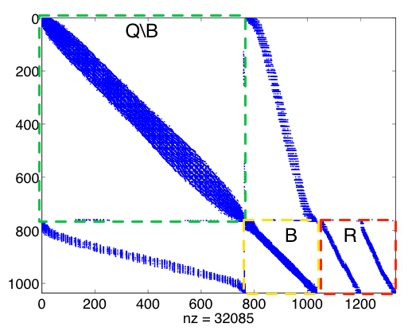
Node Ordering and Index Sets
Local Index Space
Global Index Space

Slide 56
Data Movement for Multi-GPU

Slide 57
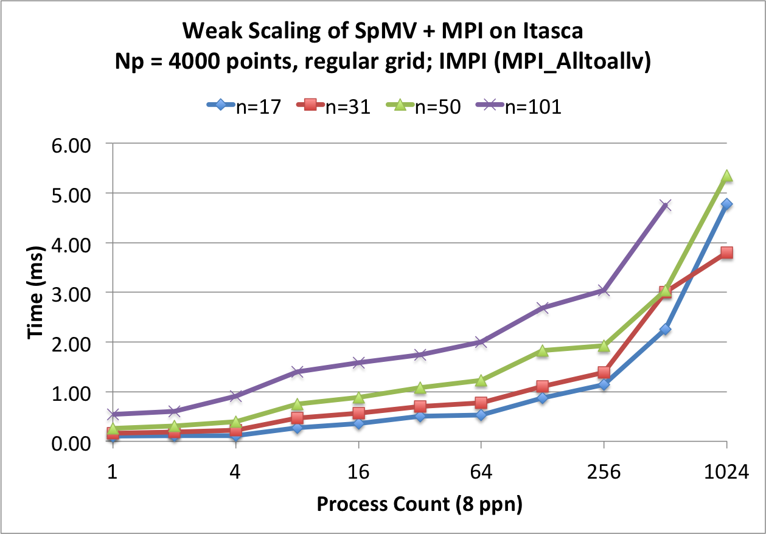
Multi-CPU Weak Scaling
Tuned on Itasca (UMN)
1,134 HP ProLiant blade servers
2x quad-core Xeon 5660 (“Nehalem EP”) processors per node
N=160³ nodes
Impact on performance for fixed problem size per processor
BEFORE (MPI_Alltoallv)

Slide 58
MPI Stages

Slide 59
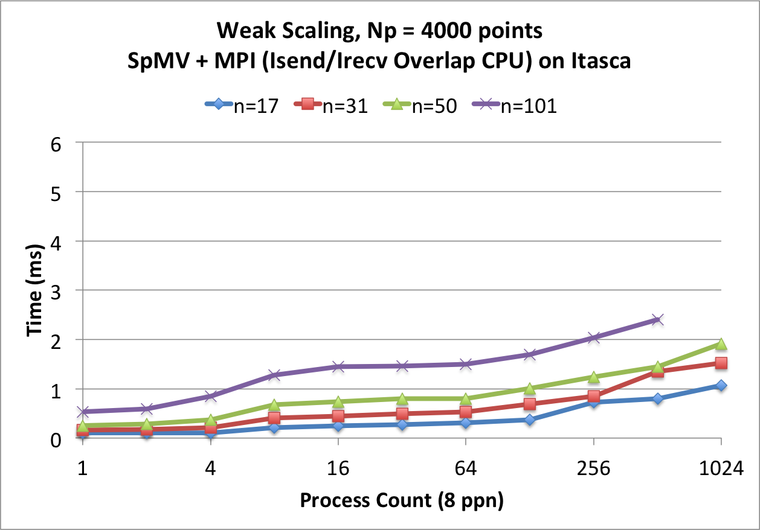
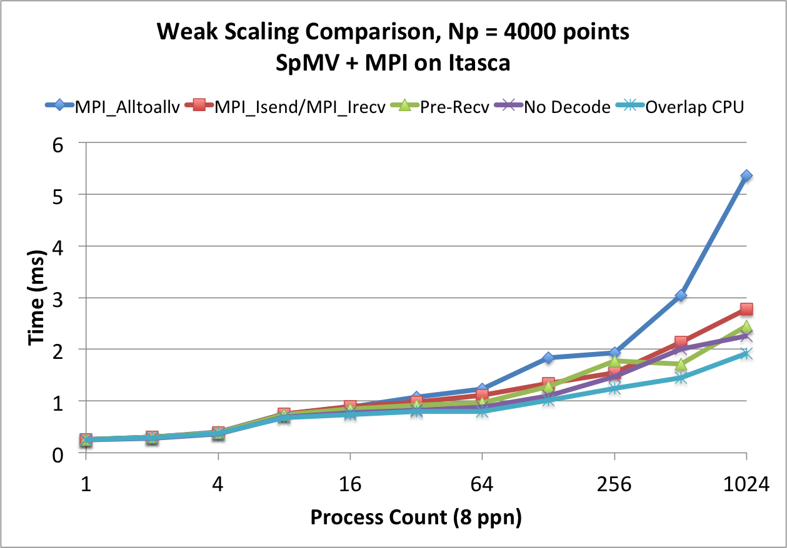
Multi-CPU Weak Scaling
2x-5x improvement at p=1024 processors
Larger N_{p} per processor would hide growth
METIS load balancing fails for p=1024, n=17:
AFTER
TUNING STEPS

Slide 60
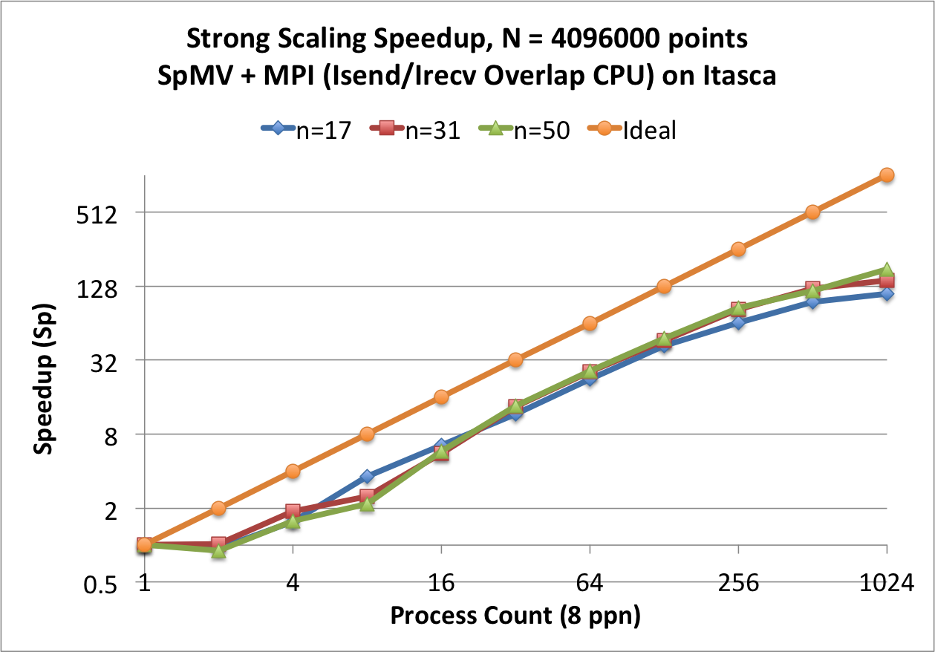
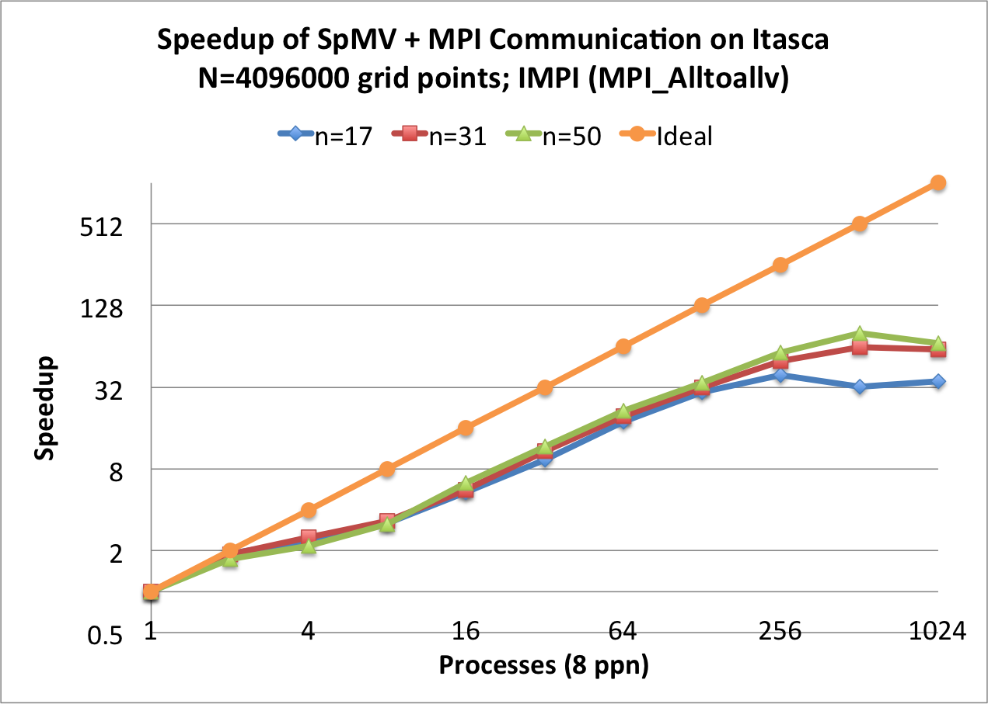
Multi-CPU Strong Scaling
Fixed global problem size with decreasing workloads
MPI_Alltoallv is 2x faster when operating on one node. Slower otherwise.
Near linear (ideal) scaling.
BEFORE
AFTER
Notes:
2-way fat-tree network
8 cores is a leaf and communicate via shared memory.
Groups of 16 nodes connect via QDR InfiniBand to \emph{leaf switches} at the second level of the tree.
All leaf switches are in turn connected to two director nodes via 4x QDR InfiniBand.
The topology exhibits 8:1 contention between nodes of the same leaf and additional 2:1 contention between leaf switches \cite{ItascaTuning}.
Our implementation of RBF-FD does not detect or adjust to network topology, so network contention may inflate communication times. Tuning for the network topology is reserved for future work.

Slide 61
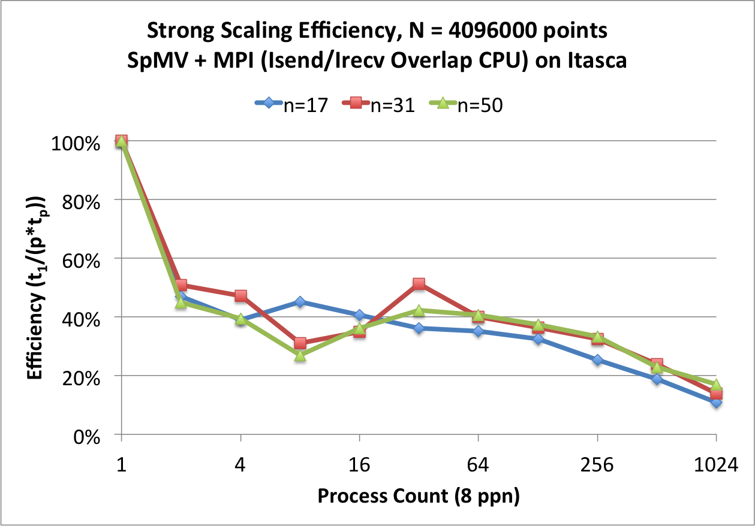
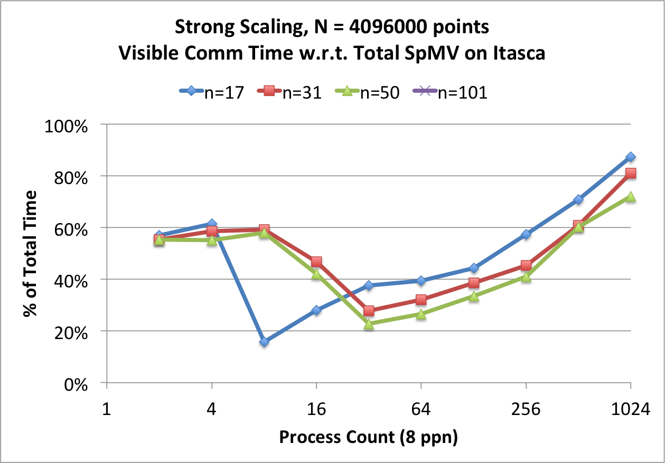
Strong Scaling Efficiency and Communication Overlap
Efficiency:
Visible Communication Time:

Slide 62
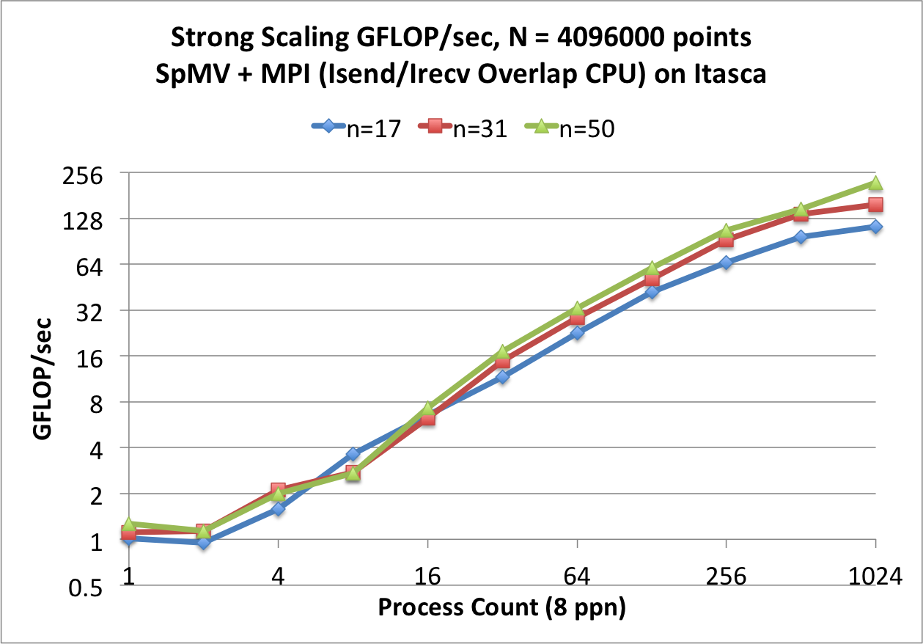
Achieved GFLOP/sec on Itasca

Slide 63
Multi-CPU Summary
Strong scaling
Scales well aside from effects of contention IB network and insufficient problem size for large p.
Weak scaling
Code scales well for small stencil sizes.
Larger N_{p} necessary to hide increasing cost of communication.
Future work:
Align messages properly for best performance
Possible FMM approach to limit communication between subddomains (Yokota et al. 2010)

Slide 64
Multi-GPU Communication
GPU adds transfers between host←→device
Run two OpenCL queues
One for SpMV[Q\B]
One for host←→device transfers and SpMV[B]
Allows overlap of communication and
MPI_Alltoallv (No Overlap)
Overlapping Collective

Slide 65
Multi-GPU Strong Scaling Cosine Bell (Keeneland M2070)
CSR Matrix with MPI_Alltoallv

Slide 66
Multi-GPU Strong Scaling (Cascade M2070s)
Known issue on Cascade: a shared I/O hub between 4 GPUs serializes data transfers. Overlapping bypasses the problem.

Slide 67
Multi-GPU Summary
Bottleneck on multi-GPUs of same node is avoided with overlapping queues.

Slide 68
Conclusions
Presented the first distributed RBF-FD implementation
Tuned MPI for decent scaling, still more optimizations possible
Ghost nodes are the source workload imbalance in subdomains
First investigation for RBF-FD on GPU and Multi-GPU
ELL format is appropriate for RBF-FD with fixed stencil size and achieves up to 8 GFLOP/sec (double precision) for a single SpMV (~43% of the roofline estimate for SpMV).
Overlapping communication and computation is essential
Bottleneck on I/O-Hub connecting multiple-GPUs on same node is avoided with overlapping queues.

Slide 69
Conclusions II
Hyperviscosity parameters stabilize RBF-FD solutions to hyperbolic equations.
Convergence is demonstrated as function of N.
Fixed-grid method can be 2.5x faster than k-D Tree (one time cost) and can result in 5x faster SpMV for quasi-random node distributions.
Space-filling curves and Reverse Cuthill-McKee do not make significant difference so we proceed with IJK (Raster) Ordering.

Slide 70
Community Outreach

Slide 71
Survey of Technologies Used
Matlab
Mathematica
OpenCL
CUDA
ParaView
NCAR Command Language (NCL) and NCAR Graphics
C++
Armadillo (http://arma.sf.net)
ViennaCL (http://viennacl.sf.net)
CUSP (https://code.google.com/p/cusp-library/)
BOOST::uBLAS (http://www.boost.org/)
METIS (http://cs.umn.edu/~metis/)
MPI (http://mpi-forum.org)

Slide 72
Current and Future Work
Return to CUDA
CUDA v5.5 features supports MPI with GPUDirect®
SpMV Improvements:
Auto-tuned kernels with clSpMV (Su and Keutzer 2012)
50+ GFLOP/sec when running in single precision
New formats:
BELL, SELL, SBELL (Su and Keutzer 2012)
ELLPACK-R, pJDS, etc. (Kreutzer et al. 2012)
Applications with Multi-Matrix SpMM (Erlebacher et al. 2013)

Slide 73
Current and Future Work II
Multiple subdomains per GPU (to saturate Fermi and Kepler cards)
Improve communication by properly aligning/padding MPI messages
Consider FMM approach for RBF-FD

Slide 74
Continued and Future Work III
Intel Phi vs NVidia Kepler
Latest hardware from Nvidia? K40*
Multi-GPU preconditioned GMRES solutions of RBF-FD for Stokes flow
Core operation of GMRES: SpMV
Current work is incomplete
with RBF-GA

Slide 75
Questions?
Remember: this is research. If we had all the answers we wouldn’t be doing it.

Slide 77
Extras

Slide 80
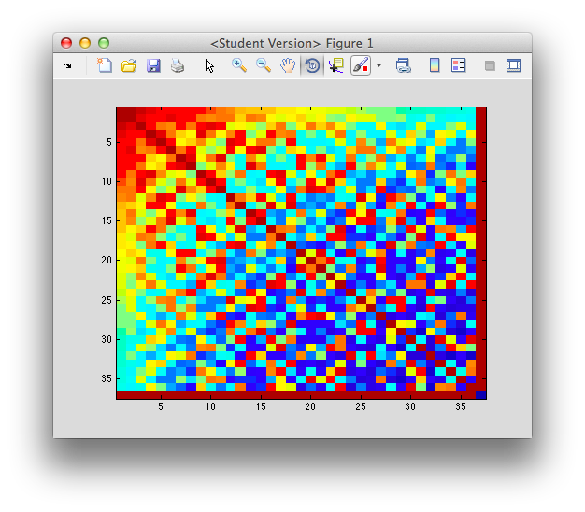
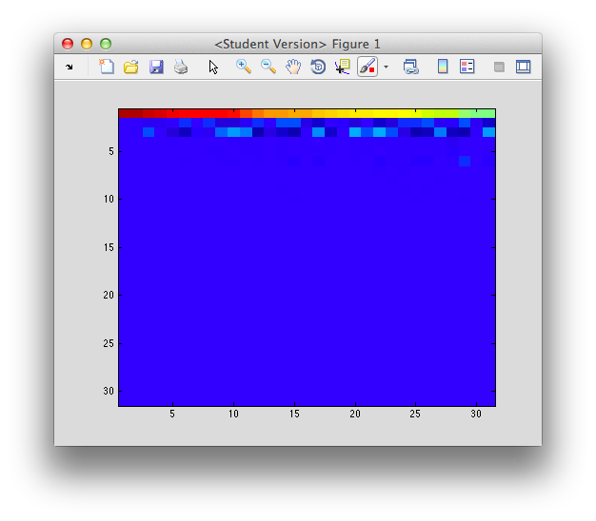
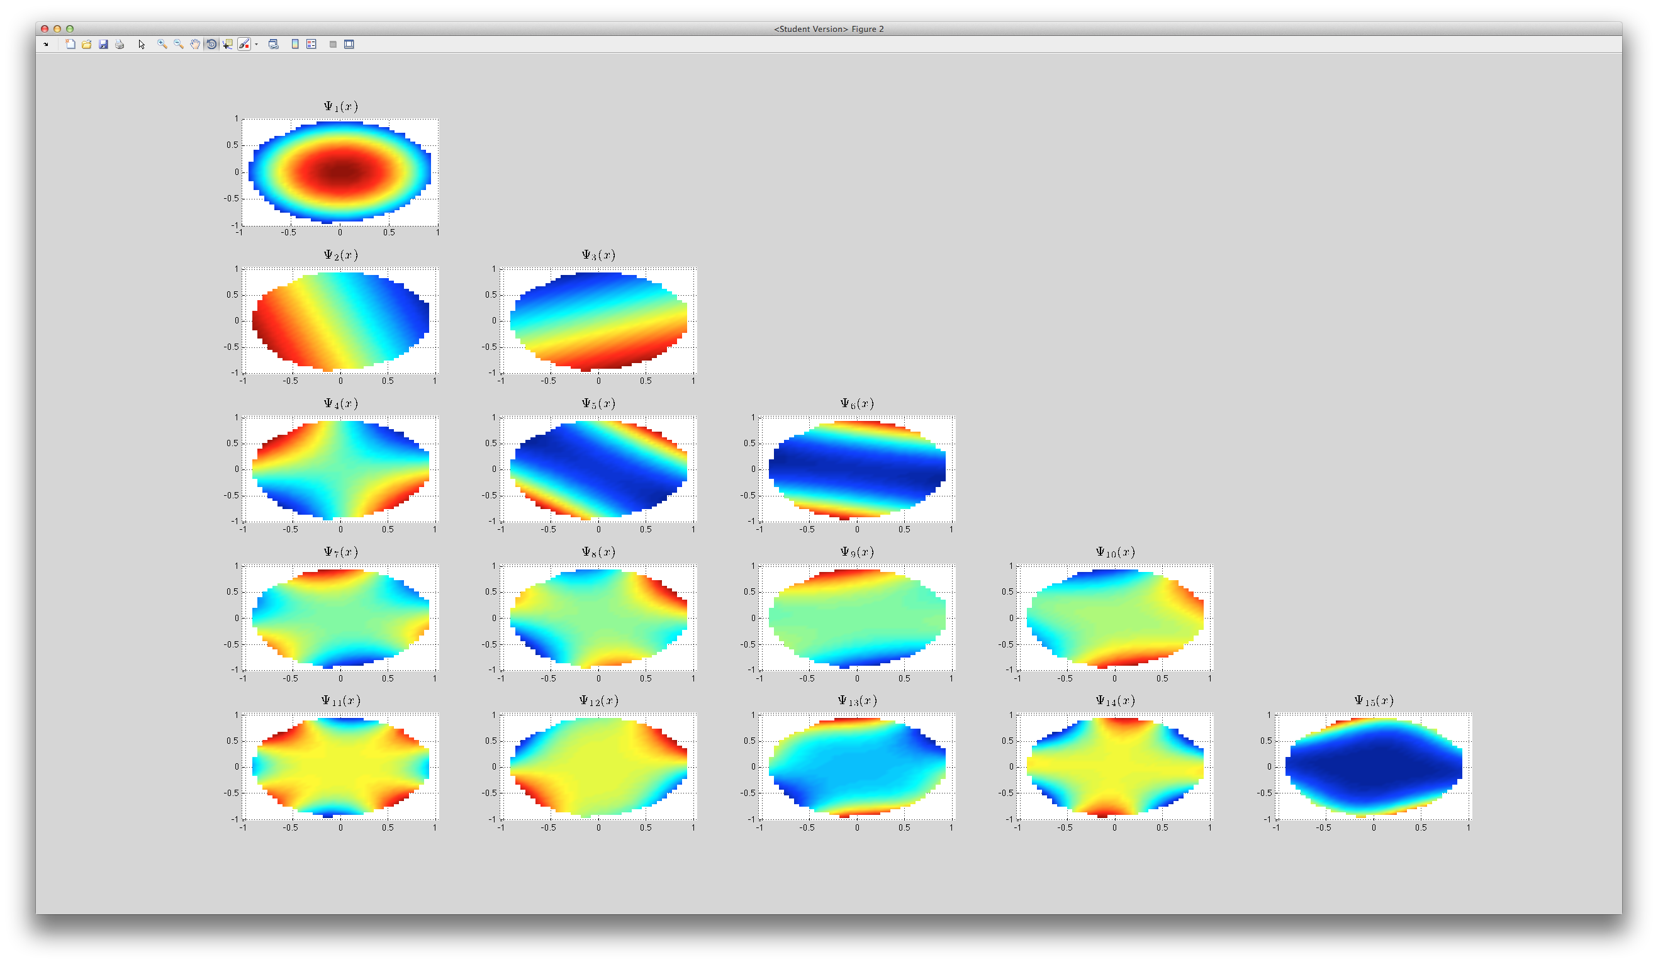
RBF-GA (Preliminary Results)

Slide 81
Keeneland Cosine Custom Kernel GFLOP/sec

